Slide 1
Introduction to Data Science
Session 1
10 March 2018

Slide 2
Agenda
Introduction to Data Science
Introduction to R
R Exercises
Q&A
Use Cases

Slide 3


About Us
William Yap
Data Scientist
Strategy Consulting
Nadav Rindler
Data Scientist
Marketing Analytics

Slide 4
Series Map
10 March - Cover first half of “The Data Scientist’s Toolbox”
24 March - Cover second half of “The Data Scientist’s Toolbox”
7 April - Cover first half of “R Programming”
28 April - Cover second half of “R Programming”
12 May - Cover first half of “Getting and Cleaning Data”
26 May - Cover second half of “Getting and Cleaning Data”

Slide 5
Series Details
Location: Universiti Tunku Abdul Rahman, Sungai Long Campus
Time: 2-4pm
Start each session with an overview of the online syllables material
Add value through first-hand experience in the local environment and customized exercises for participants

Slide 6
Agenda
Introduction to Data Science
Introduction to R
R Exercises
Q&A
Use Cases

Slide 7

Drew Conway’s Data Science Venn diagram

Slide 8
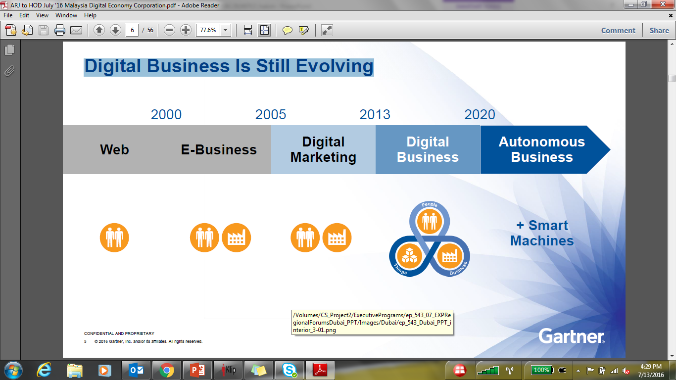
Digital Economy Evolution
Web & E-Business
Digital Marketing
Autonomous Businesses
Digital Businesses
2000
2005
2013
2020
+
Smart
Machines

Slide 9




Welcome to the New World
The world’s most popular media owner, creates no content.
The world’s largest taxi company, owns no vehicles.
The world’s largest accommodation provider, owns no real estate.
The most valuable retailer, has no inventory.

Slide 10
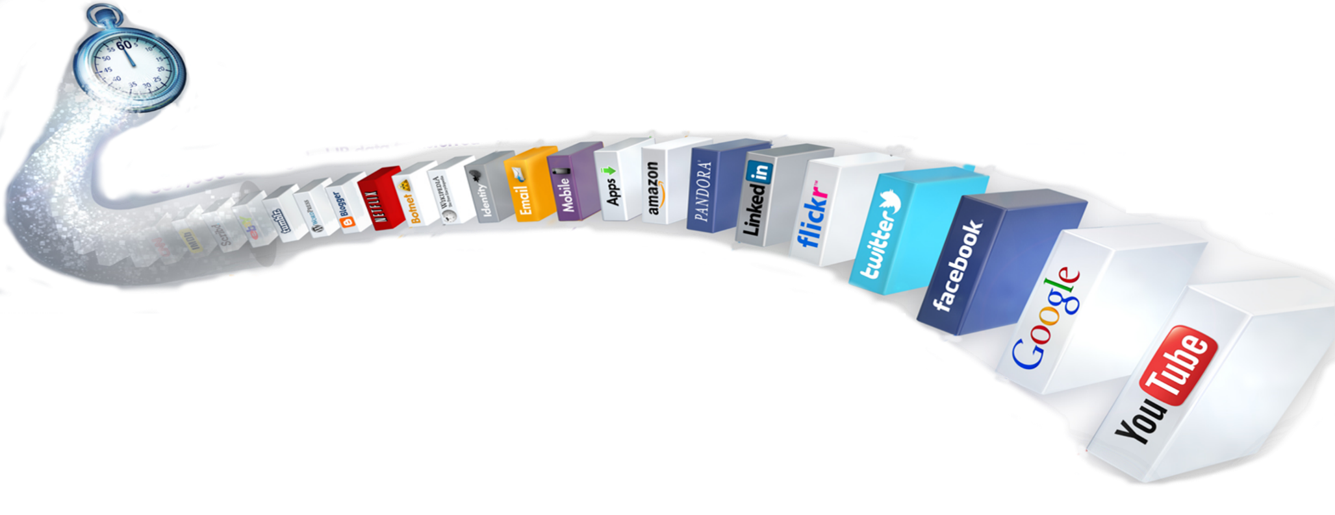
Big Data Explosion
47,000
20 million
3,000
204 million
$83,000
Photo views
Photo uploads
App downloads
Emails sent
In sales
61,141
Hours of music
320
100,000
New twitter accounts
New tweets
1,300
100+
New mobile
users
New Linkedin
accounts
277,000
6 million
What Happens in an Internet Minute?
Logins
Facebook views
2+ million
Search queries
30
1.3 million
SOURCE: INTEL
Hours of videos
uploaded
Video views

Slide 11
Data Science Definition
Data Science is an interdisciplinary field of scientific methods to provide meaningful information from large amounts of complex data
It employs techniques and theories drawn from many fields within the broad areas of mathematics, statistics, information science, and computer science

Slide 12


Data Analytics vs Data Science
Data Analytics = Finding Right Answers
Data Science = Finding Right Questions

Slide 13

Data Scientists: What People Say
“The sexiest job of the 21st century” Harvard Business Review, Oct 2012
“Person who is better at statistics than any software engineer and better at software engineering than any statistician” Josh Wills, May 2012
“The data scientist was called, only half-jokingly, ‘a caped superhero’” Wall Street Journal, Apr 2012

Slide 14
Drew Conway’s Data Science Venn diagram

Slide 15
Top Jobs of the Future
Job | Job openings | Median base salary | Career opportunity | Job score
1. Data Scientist | 1,736 | $116,840 | 4.1 | 4.7
2. Tax Manager | 1,574 | $108,000 | 3.9 | 4.7
3. Solutions Architect | 2,906 | $119,500 | 3.5 | 4.6
4. Engagement Manager | 1,356 | $125,000 | 3.8 | 4.6
5. Mobile Developer | 2,251 | $90,000 | 3.8 | 4.6
6. HR Manager | 3,468 | $85,000 | 3.7 | 4.6
7. Physician Assistant | 3,364 | $97,000 | 3.5 | 4.6
8. Project Manager | 6,607 | $106,680 | 3.3 | 4.5
9. Software Engineer | 49,270 | $95,000 | 3.3 | 4.5
10. Audit Manager | 1,001 | $95,000 | 3.9 | 4.5
Source : Glassdoor, 2016

Slide 16
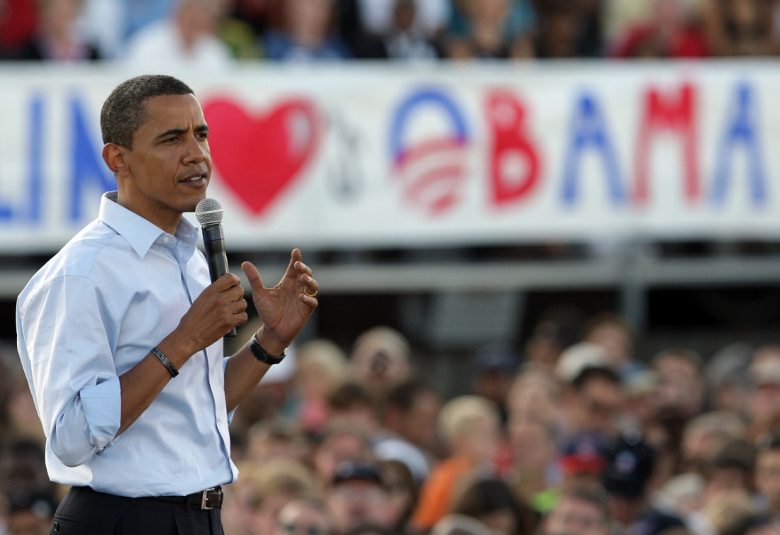
Applications of Data Science
USA Election 2012
The Obama campaign recruited a team of data scientists
Allowed the Obama campaign to create a portrait of shifting voter allegiances
The power of this operation stunned the Romney team as they saw voters they never even knew existed

Slide 17
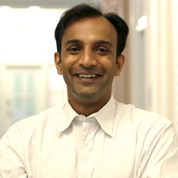
Applications of Data Science
US Government’s first Chief Data Scientist
Dr. Dhanurjay "DJ" Patil
Harvard Business Review “Data Scientist: The Sexiest Job of the 21st Century”
Credited with coining the term “Data Science”

Slide 18

What Happened?

Slide 19
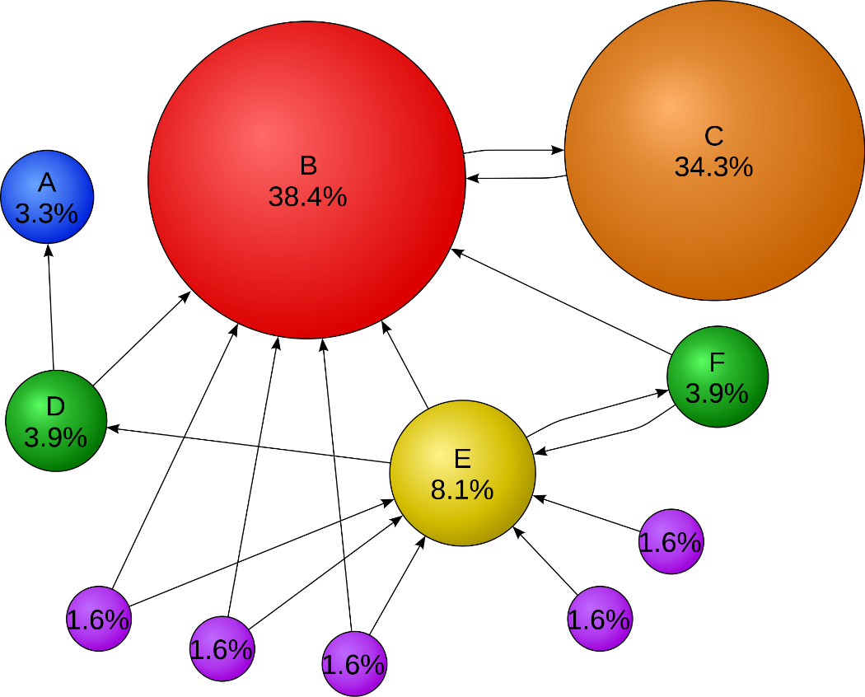
Applications of Data Science
GOOGLE
PageRank is an algorithm used by Google Search to rank websites in their search engine results

Slide 20
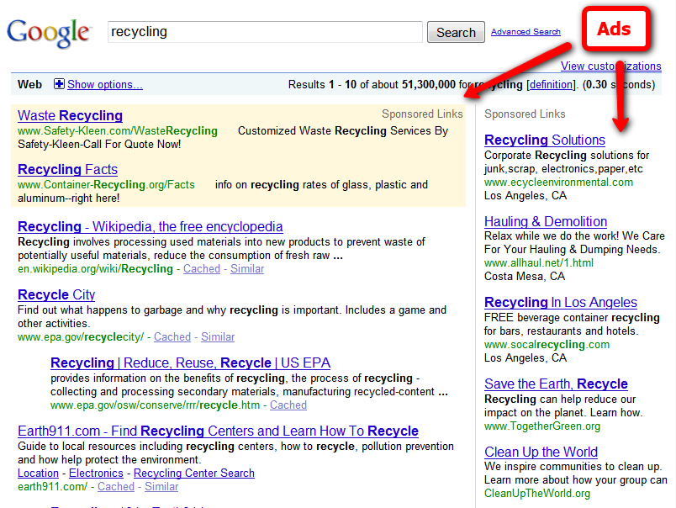
Applications of Data Science
GOOGLE ADS

Slide 21
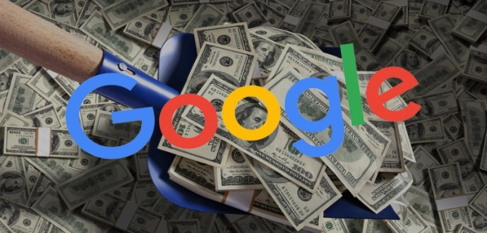
Applications of Data Science
There are around 30 billion search requests a month.
Google revenue around $50 billion per year from marketing, 97% of the companies revenue.

Slide 22

Application in Insurance Industry
In 2017, Fukoku Mutual Life Insurance Company replaced 34 employees with IBM Watson
Used AI to calculate insurance payouts to policyholders
Target to increase productivity by 30% and save $1.2m per year

Slide 23
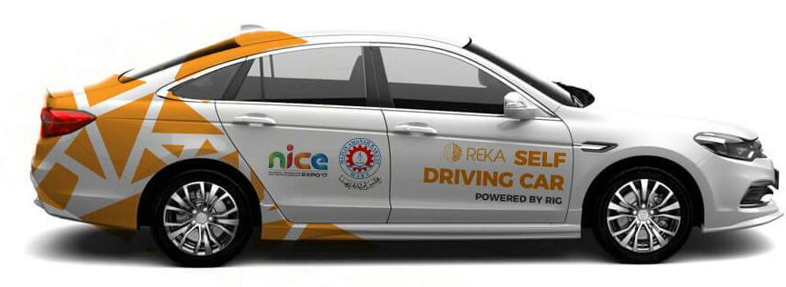
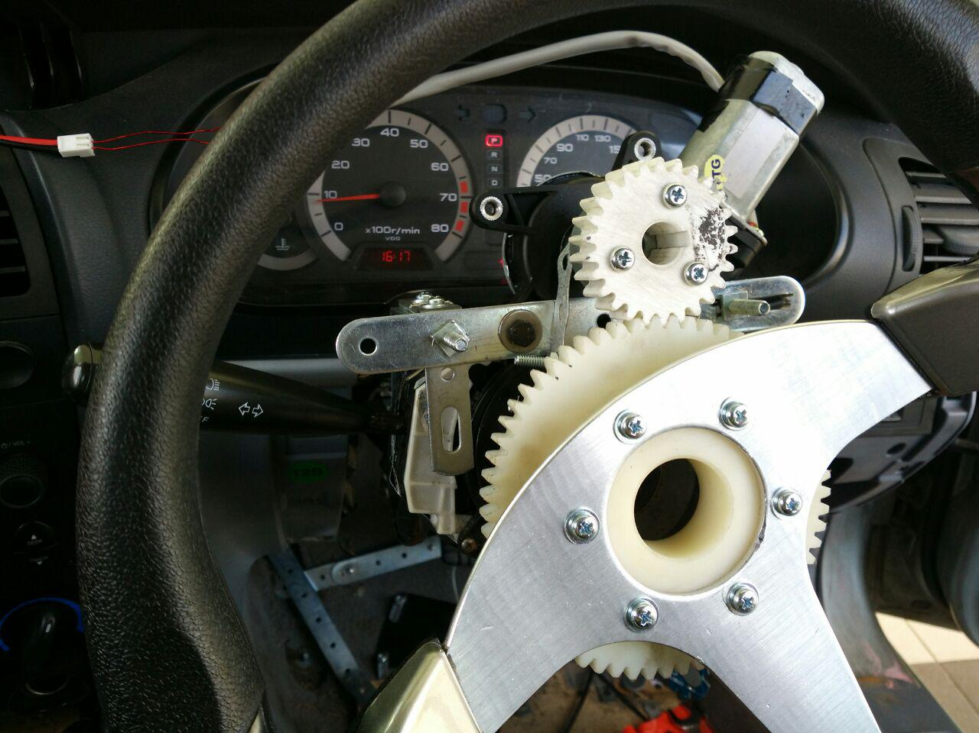
REKA Self Driving Cars
Since 2016, REKA has been developing its own self-driving tech
Tested the self-driving car from KL to Melaka with no driver
Speed 60 - 80 km/h with navigation based on Google Maps

Slide 24






How to become a Data Scientist

Slide 25
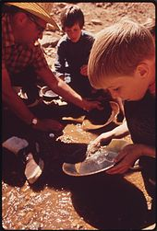
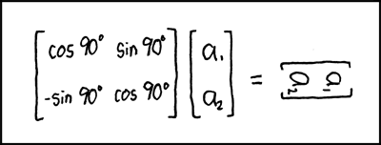
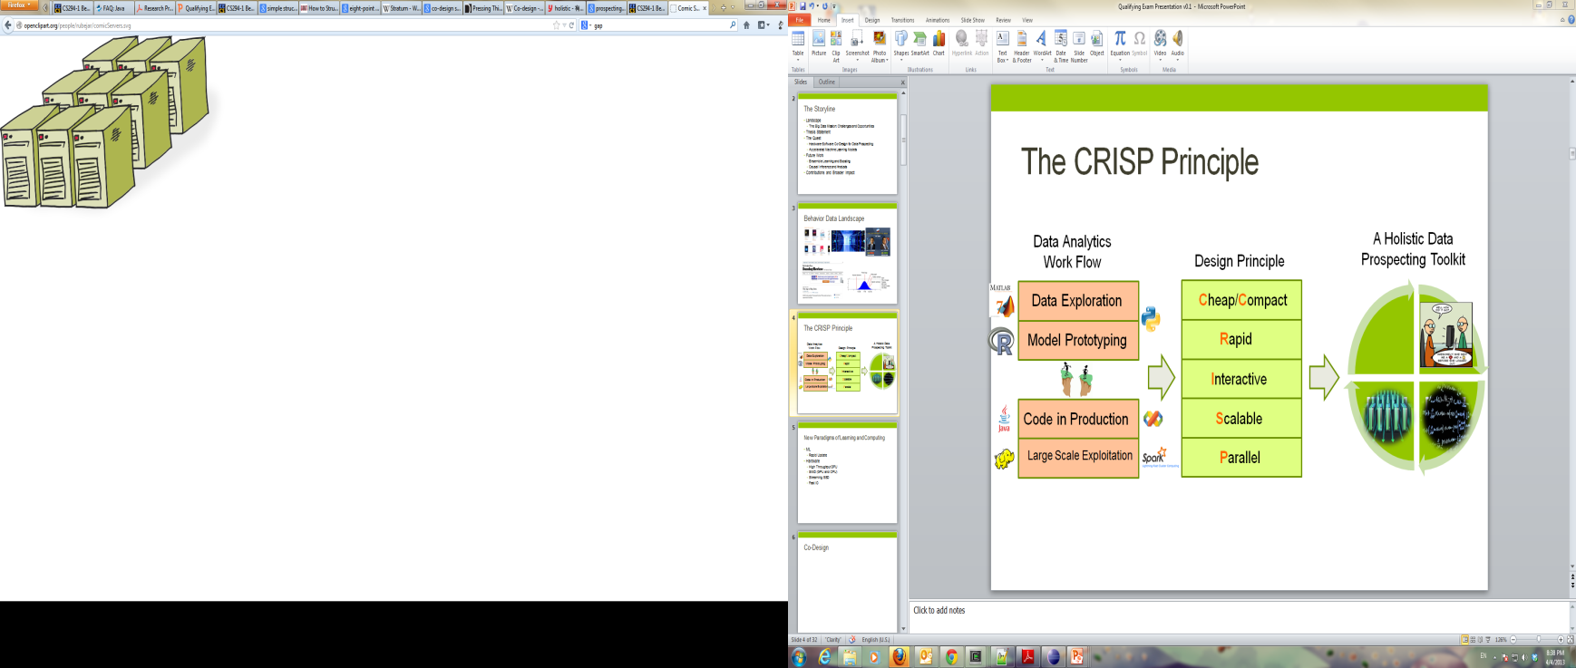
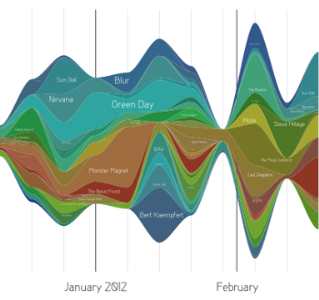
Data Scientist’s Practice
Clean,
prep
Hypothesize Model
Large Scale Exploitation
Digging Around in Data
Evaluate Interpret

Slide 26
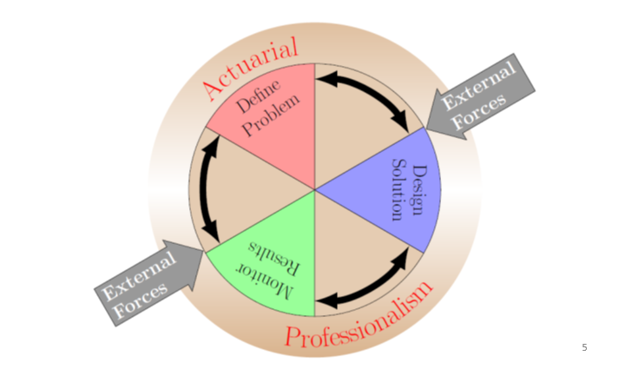
Actuarial Control Cycle

Slide 27
R studio
R Studio is a free and open-source integrated development environment (IDE) for R.
R is a programming language for statistical computing and graphics.
Commonly used for data exploration.

Slide 28
Predicting Loan Default
A total of 300 past loans with 10 variables and 1 classification (loanStatus = Active or Default).
Will be using the Random Forest Algorithm to predict the loanStatus based on the other variables.

Slide 29
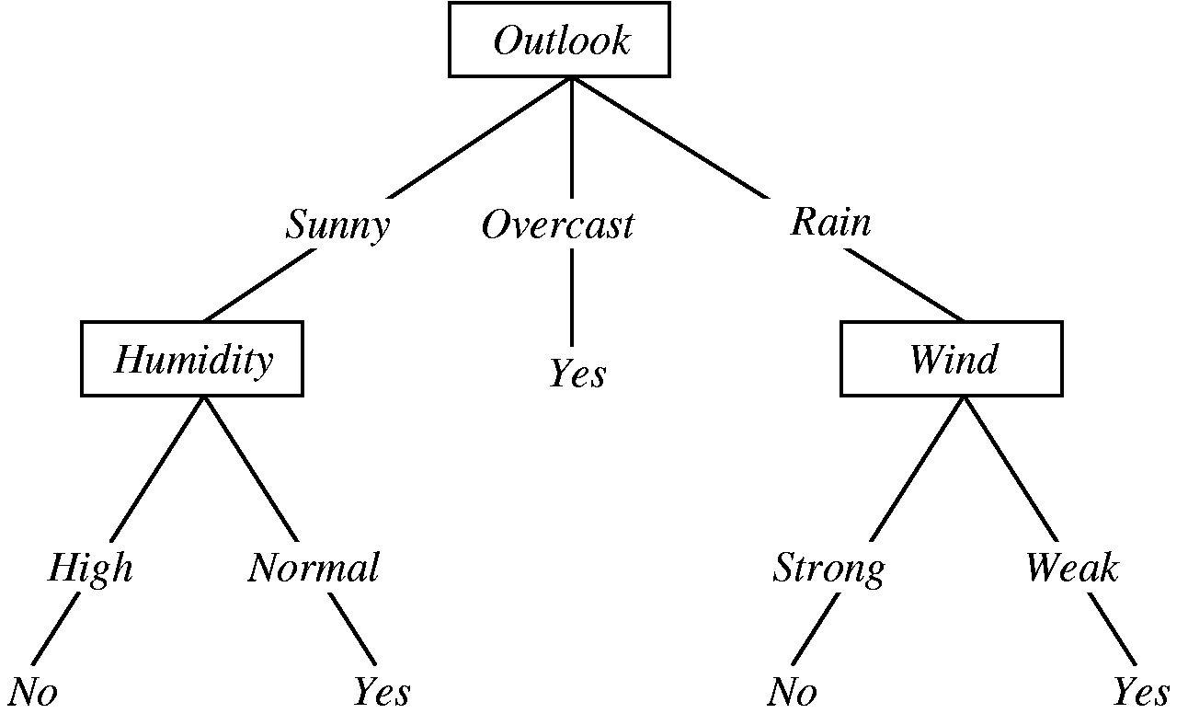
Decision Tree

Slide 30
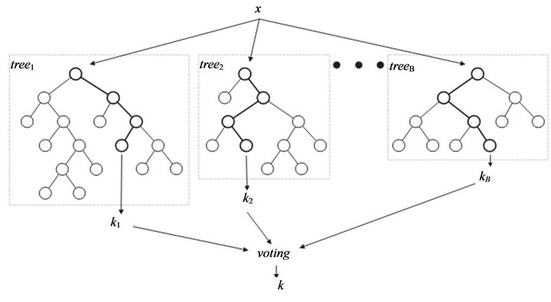
Random Forest

